Slide 1
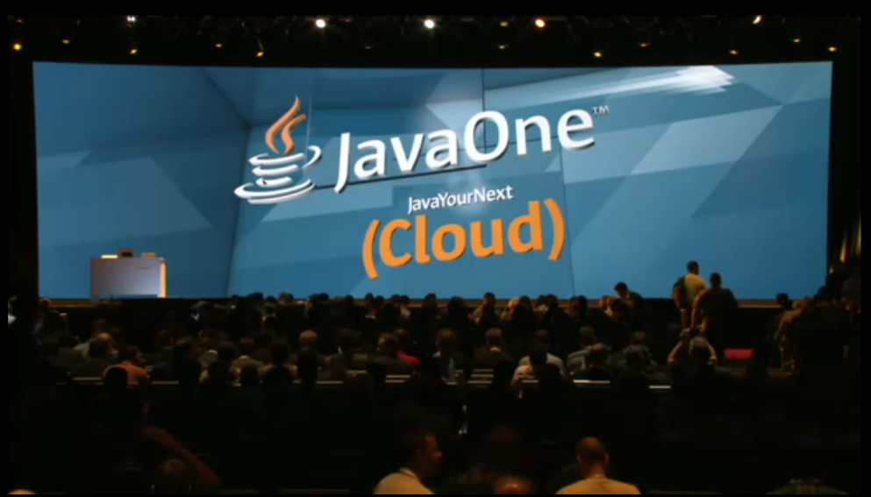

Slide 2


Slide 3
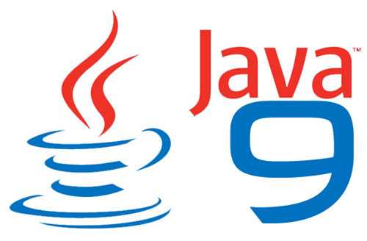
Java Development Kit 9: some new features
Big new feature is Modularity (project Jigsaw)
Covers numerous different areas: modules, Jlink etc
Smaller developer features
Streams
Jshell
Parser API for Nashorn (JEP 236)
Searchable API documentation (JEP 225)
Finally! Java API enters the 21th century
Many smaller performance/standards features
JEP = JDK enhancement proposal
Nashorn = Javascript engine in JDK

Slide 4
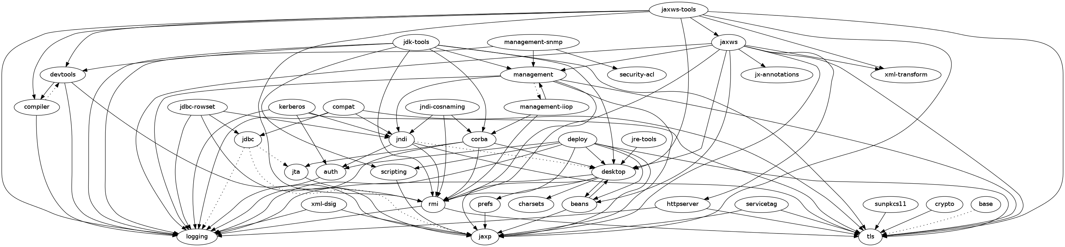
Project Jigsaw
module graph for JDK 8

Slide 5
Project Jigsaw
The JDK 8 is big and deeply interconnected,
with many undesirable dependencies between APIs and different areas of the implementation

Slide 6
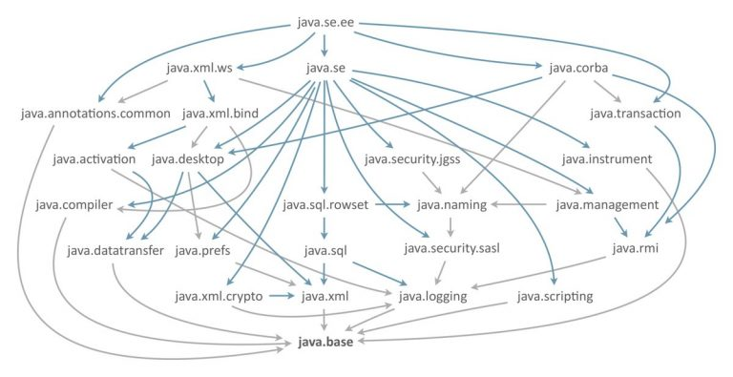
Project Jigsaw

Slide 7

Project Jigsaw

Slide 8
Project Jigsaw
The Java Platform Module System specifies a distribution format for collections of Java code and associated resources
Initially being developed under the Java Community Process as JSR 277
Scheduled to be released with Java 7 (2011)
JSR 277 later was put on hold and Project Jigsaw was created to modularize the JDK.
This JSR was superseded by JSR 376: Java Platform Module System.
JSR = Java Specification Request
JDK = Java Development Kit
JRE = Java Runtime Environment
JEP = JDK enhancement proposal

Slide 9

Project Jigsaw
Define a modular structure for the JDK (JEP 200)
Modular Source Code (JEP 201)
Current (pre Java 9) source code jar files are too big, especially rt.jar.
JDK source code re-organised to support (smaller) modules
Enhance the build system to compile modules
Enforce module boundaries at build time
Not the module system
Modular Run-Time Images (JEP 220)
Restructure the JDK and JRE run-time images,
to accommodate modules and to improve performance, security, and maintainability
JDK now has 94 modules (Java SE is 36)
JSR = Java Specification Request
JDK = Java Development Kit
JRE = Java Runtime Environment
JEP = JDK enhancement proposal

Slide 10
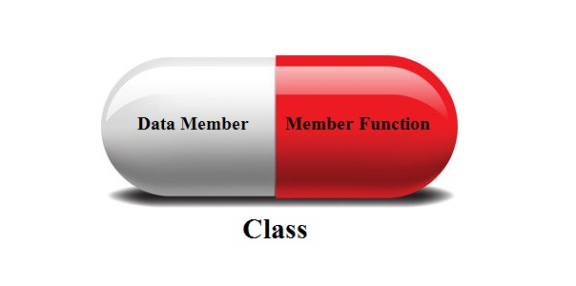
Project Jigsaw
Encapsulate Most Internal APIs (JEP 260)
Make most of the JDK’s internal APIs inaccessible by default,
but leave a few critical, widely-used internal APIs accessible.
sun.misc.Unsafe,
intended for use by core Java classes and mostly used to modify platform functionality for a specific purpose
encapsulation can be broken with command line options:
--add-exports
--add-opens
Java Platform Module System (JEP 261)
Allow the user to create their modules to develop their applications.
JSR = Java Specification Request
JDK = Java Development Kit
JRE = Java Runtime Environment
JEP = JDK enhancement proposal

Slide 11
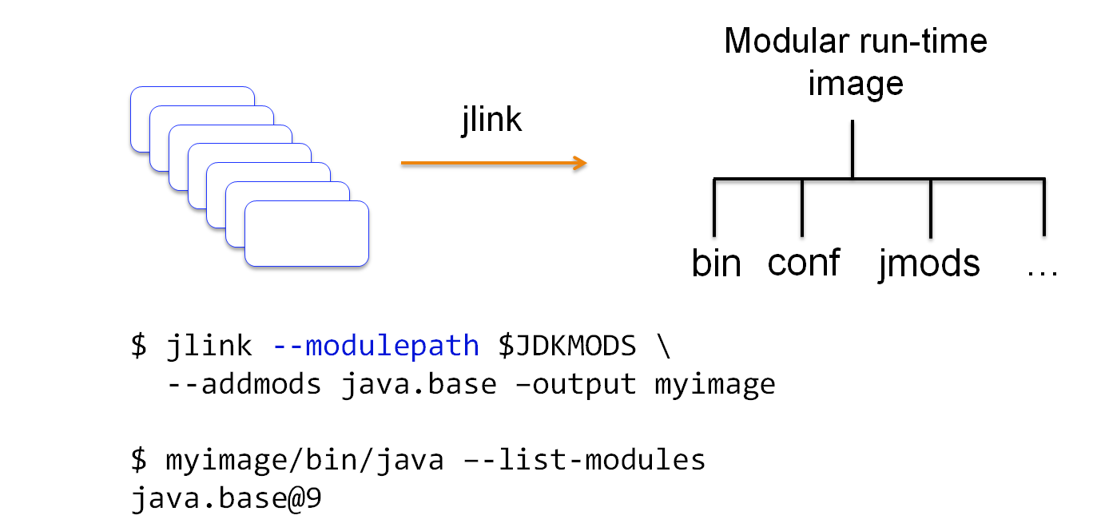
Project Jigsaw
JLink: the Java Linker tool (JEP 282)
Allow the user to create executable to their applications.
Java’s new command line tool which allows you to link sets of modules to create a run-time image.
It will allow you to both simplify and reduce the size of deployment

Slide 12
Project Jigsaw
The base module is essentially the core libraries, including java.lang, java.io, java.net, java.nio, and security.
The dependencies that used to be required by the base module such as logging, AWT, JNDI, etc are removed.
The base module still optionally requires XML and SSL/TLS that needs to be addressed.
Logging no longer requires JMX, JNDI no longer requires java.applet.Applet, JavaBeans no longer requires JDBC, AWT no longer requires RMI, and many more.
AWT, Swing, 2D and other client components are grouped into a desktop module.
Headless applications can run without the desktop module being present.

Slide 13
Project Jigsaw
Applications can now be installed with just those components of the JDK that they actually require.
improves performance
enhances security
lowers (memory) footprint
Improves scalability

Slide 14
Project Jigsaw
Compatibility is an issue:
Mostly for libraries and frameworks
Which most people use
Override encapsulation of private APIs
Leave everything on classpath to start with.
“Big kill switch” now has options
Turns off encapsulation completely by default
--illegal-access={permit,warn,debug,deny}
–illegal-access=permit
This will be the default mode for JDK 9.

Slide 15
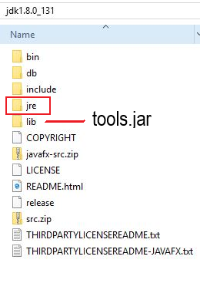
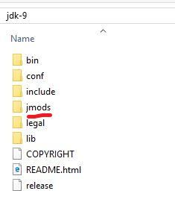
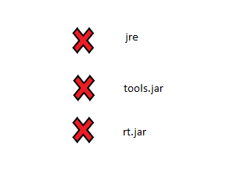
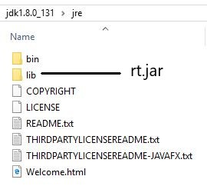
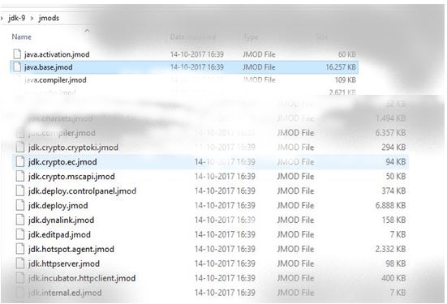
JDK 8 vs 9 structure

Slide 16
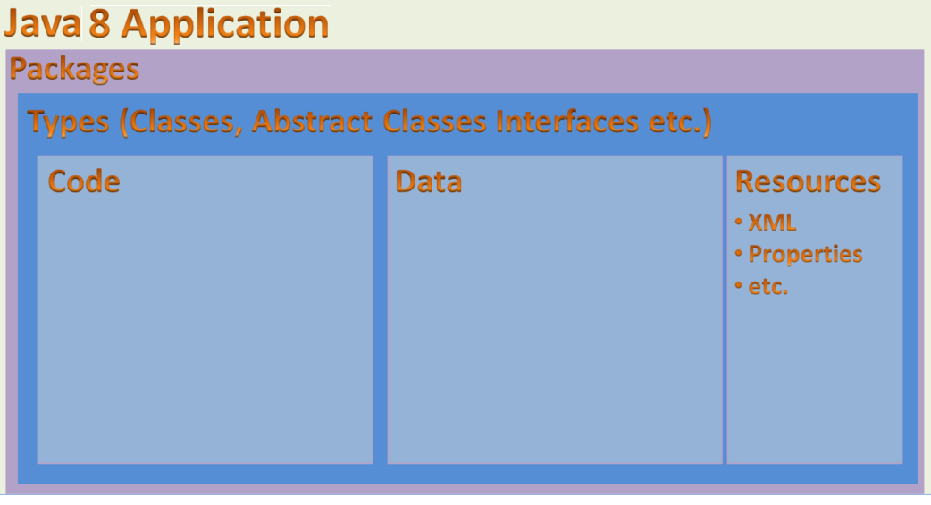
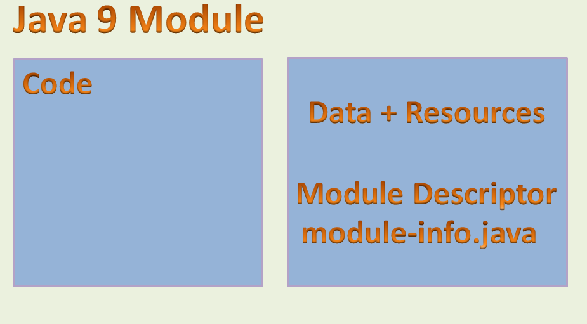
Java 9 modularity

Slide 17
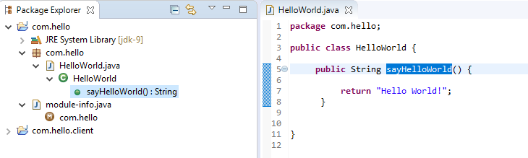
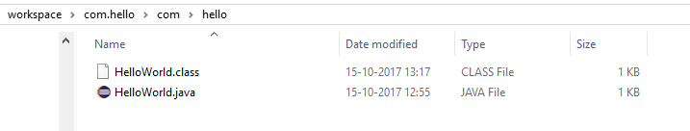
Java 9 modularity
javac -d output com.hello\com\hello\HelloWorld.java

Slide 18
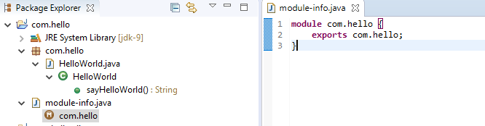
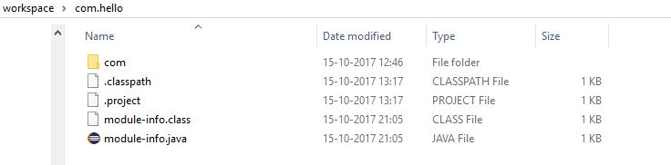
Java 9 modularity
javac -d output com.hello\module-info.java

Slide 19
Java 9 modularity
javac -d output com.hello\com\hello\HelloWorld.java
javac -d output com.hello\module-info.java
Maak de module com.hello.jar in een folder mlib:
jar -c -f mlib\com.hello.jar -C output .
Verwijder de ‘tijdelijke’ output folder:
rmdir /s output
output, Are you sure (Y/N)? Y

Slide 20
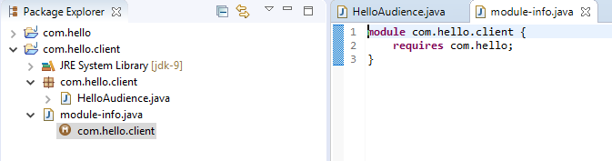
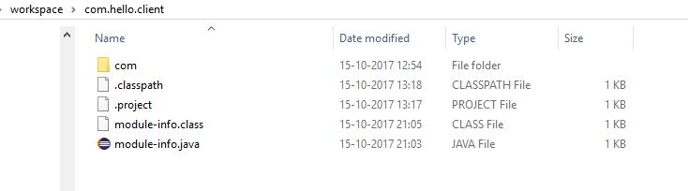
Java 9 modularity
javac --module-path mlib -d output com.hello.client\module-info.java

Slide 21
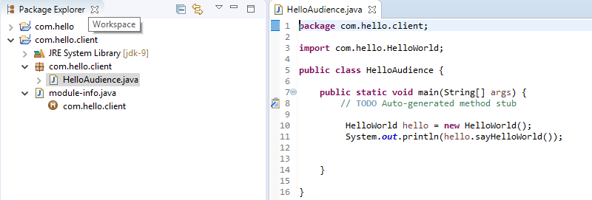
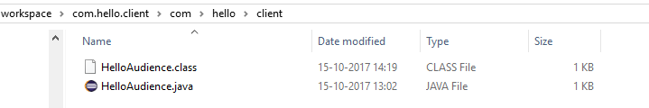
Java 9 modularity
javac --module-path mlib -d output com.hello.client\com\hello\client\HelloAudience.java

Slide 22

Java 9 modularity
java –module-path “mlib;output” -m com.hello.client/com.hello.client.HelloAudience

Slide 23
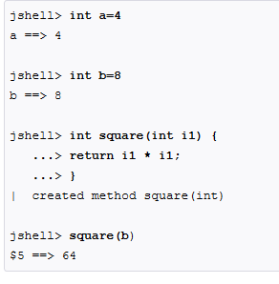
Jshell : The Java Shell (JEP 222)
Delivered by project Kulia
Adds Read-Eval-Print Loop (REPL) functionality to the Java platform.
Interactively evaluate declarative statements and expressions

Slide 24

Enhanced Streams API
Streams in Java let developers express calculations so that data parallelism can be efficiently exploited.
New features/methods:
dropWhile()/takeWhile()
conditionally take and drop items from Stream
(like skip/limit but uses Predicate rather than number)
Improved iterate
Enables a stream to be more like a for loop
Parallel Files.lines()
Memory mapped, divided on line break boundary
Stream from Optional
Create a stream from a nullable value
= Stream of zero or one element

Slide 25
Convenience Factory Methods for Collections (JEP 269)
Static factory methods on List, Set and Map interfaces
Create compact, immutable instances
0 to 10 element overloaded versions
Plus varargs version for arbitary number of elements
Set<String> set = new HashSet<>();
set.add("a");
set.add("b");
set.add("c");
set = Collections.unmodifiableSet(set);
Set<String> set = Set.of("a", "b", "c");

Slide 26
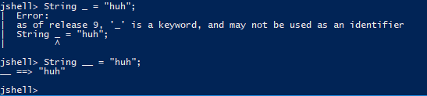
Project Milling coin (JEP 213)
Single underscore no longer valid as identifier
Ready for use in Lambdas
Private methods in interfaces
Multiple inheritance of behaviour makes this logical
Effectively final variables in try-with-resources
Variables from outside try block
Allow @SafeVarargs on private instance methods
In addition to constructors, final and static methods
Diamond operator with anonymous classes
Extending type inference further

Slide 27
Project Nashorn
A lightweight JavaScript runtime for Java, delivered in Java 8
JEP 236
JDK 9 includes a parser API for Nashorn’s ECMAScript syntax tree.
The package jdk.nashorn.api.tree contains the Nashorn parser API
JEP 292
Implements many new features introduced ECMAScript 6 :
Template strings
let, const, and block scope
Iterators and for..of loops
Map, Set, WeakMap, and WeakSet
Symbols
Binary and octal literals
The API enables ECMAScript code analysis by IDEs and server-side frameworks without depending on Project Nashorn’s internal implementation classes.

Slide 28
New Version-String scheme (JEP 223)
A new simplified version-string format that helps to clearly distinguish major, minor, security, and patch update releases.
The new version-string format is as follows:
$MAJOR.$MINOR.$SECURITY.$PATCH
$MAJOR is the version number that is incremented for a major release, for example JDK 9, which contains significant new features as specified by the Java SE platform specification. A major release contains new features and changes to existing features, which are planned and announced well in advance.
$MINOR is the version number that is incremented for each minor update, such as bug fixes, revisions to standard APIs, or implementation of features outside the scope of the relevant platform specifications.
$SECURITY is the version number that is incremented for a security-update release, which contains critical fixes, including those necessary to improve security.
$PATCH is the version number that is incremented for a release containing security and high-priority customer fixes that have been tested together.

Slide 29
HTTP/2 client API
Upgrade to the web’s core HTTP protocol
Can replace the HttpURLConnection API
WebSocket is supported by the API as well.

Slide 30


Improved HTML5 and Unicode support
Javadoc documentation tool is enhanced to generate HTML5 markup.
The Unicode 8.0 encoding standardis supported as well.
—which adds 8,000 characters, 10 blocks, and six scripts—

Slide 31
Deprecated Applet API (JEP 289)
Security-conscious browser makers have been removing support for Java browser plug-ins.
The appletviewer tool is being deprecated as well
Now use Java Web Start, for launching applications from a browser, or installable applications.

Slide 32
Deprecated Concurrent Mark Sweep garbage collector (JEP 291)
The low-pause G1 garbage collector is intended to be a long-term replacement for CMS (JEP 248).
Aim is to speed up the development of other garbage collectors in the HotSpot virtual machine.

Slide 33
Removed
Oracle has removed the JVM TI (Tool Interface) hprof (Heap Profiling) agent, which has been superseded in the JVM.
The jhat tool was removed as well, having been made obsolete by superior heap visualizers and analyzers.
JVM TI hprof agent (JEP 240)
Only ever intended as a demo of JVM TI
Useful features now in other tools (like jmap)
Jhat tool (JEP 241)
Experimental tool added in JDK 6
Unsupported
Better heap visualization tools available

Slide 34
Removed
6 deprecated APIs (JEP 261)
{Add, Remove}ActionListener
Pack200, Unpack200 and LogManager
com.sun.security.auth.callback.DialogCallbackHandler
Part of JAAS
JRE version selection command line option (JEP 231)
-version:release no longer accepted
-version still works
Demos and samples (JEP 298)
JEP = JDK enhancement proposal
JAAS= Java Authentication and Authorization Service

Slide 35
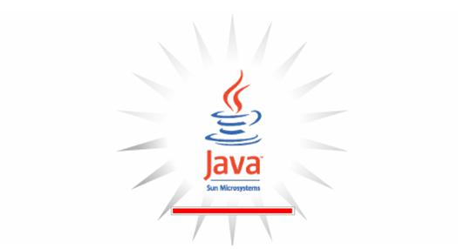
Cleanup
SHA-1 cerificates (JEP 288)
Mostly, in some situations SHA-1 certificates will be accepted
Deprecate the Applet API (JEP 280)
Plugin not supported any longer by other large browser vendors
JEP = JDK enhancement proposal
JAAS= Java Authentication and Authorization Service

Slide 36
Future releases
Java is planned to have a six-month release cadence,
Now using $YEAR.$MONTH version scheme
with the next major version, to be called Java 18.3, due March 2018,
followed by Java 18.9 six months later.

Slide 38


Slide 39


Slide 40


Slide 54



Slide 55


Slide 59


Slide 60


Slide 61


Slide 64


Slide 65


Slide 66


Slide 68


Slide 69


Slide 70


